Slide 1
Edo university angular
Jose Antonio amores tomás

Slide 2
index
WHO I AM?
INTRODUCTION
IMPORTANT FEATURES
SET UP AN ANGULAR PROJECT
HOW ANGULAR CLI WORKS
LAZY LOADING
COMPONENTS
COMPONENTS LIFE CYCLE
TEMPLATES
BUILT-IN DIRECTIVES
PIPES
ROUTING BASICS
RXJS AND OBSERVABLES
DIFFERENCES BETWEEN PROMISES AND OBSERVABLES
HANDLING RESPONSES AND ERRORS WITH OBSERVABLES

Slide 3

Who i am ?
My name is Jose Antonio Amores Tomás.
I have studied DAW
(Desarrollo de Aplicación Web)
I have 9 months of experience as a frontend developer.

Slide 4


introduction
Angular is a platform and framework for building client applications in HTML and TypeScript.
It is used to build so-called Single Page Applications (SPA).
The main page is loaded only once, and the content is refreshed by the framework.

Slide 5
Important features
HTML code more expressive (Data binding, directives, etc…)
It’s modular.
Reusable components in others apps.
Very easy to integrate with the back-end.
Powerful debugging tools like Augury (Chrome).
Testing frameworks like Karma or Jasmine.
Integration with some design frameworks

Slide 6
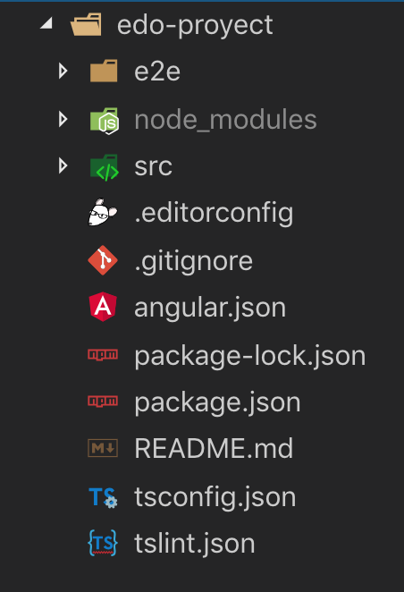
Set up an angular project
Use the Angular CLI.
This is a command line tool that not only allows to generate Angular projects fast and easily, but also manages them.
First of all we’ll need to install this tool with NPM:
npm i @angular/cli -g
To create a new proyect:
ng new PROJECT-NAME

Slide 7
How angular-cli works
angular-cli is a new tool for creating and managing Angular 2+ projects.
This tool makes our lives easier by automatizing all typical tasks and letting us focus only on coding, while angular-cli does the rest.
Generating Components, Directives, Pipes and Services
ng generate or ng g → more information in official documentation.

Slide 8
Lazy loading
An Angular application must have a main module (@NgModule), and can have also other submodules.
This will be very useful in order to load only the parts needed from our application in the browser when running the app for the first time (lazy loading).
Our main application module is created in the file src/app/app.module.ts.

Slide 9
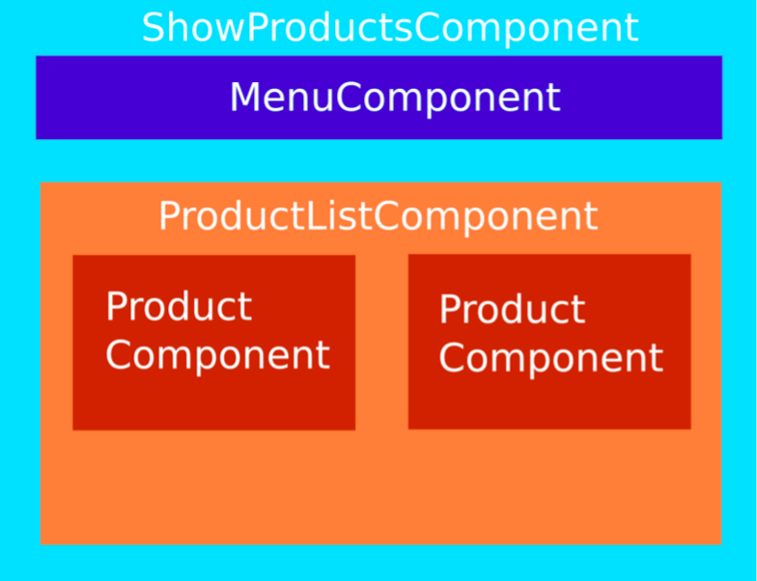
components
In Angular, a component can be understood as a controller class for a view.
There will be a main component for the view, and also, there can be nested components (reusable in other parts of our application) controlling specific parts of the page (view):

Slide 10
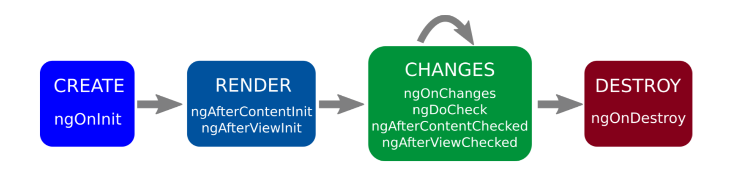
Components life cycle

Slide 11
Templates
If we consider our components to be controller classes, templates can be considered their views.
A component is in charge of manipulate and interact with its template, and the way to do this is by using interpolation and data binding.

Slide 12
Built-in directives (*ngFor)
The directive *ngFor allows us to iterate through this products collection and generate the necessary HTML (table row) to display them.
index: number: The index of the current item.
first: boolean: True when the item is the first item.
last: boolean: True when the item is the last item.
even: boolean: True when the item has an even index.
odd: boolean: True when the item has an odd index.

Slide 13
Built-in directives (*ngIF)
The ng-if directive removes the HTML element if the expression evaluates to false.
If the if statement evaluates to true, the Element is added in the DOM.

Slide 14
Built-in directives (NGCLASS)
The CSS classes are updated as follows, depending on the type of the expression evaluation.
The [ngClass] directive allows us to assign different classes to an element based on boolean attributes or conditionals.

Slide 15
pipes
Pipes are usually used with interpolation and data binding to transform the data before it’s displayed. They can be considered as filters. Angular provides some built- in pipes for operations with strings, arrays, dates, JSON, currency, locales, ...

Slide 16
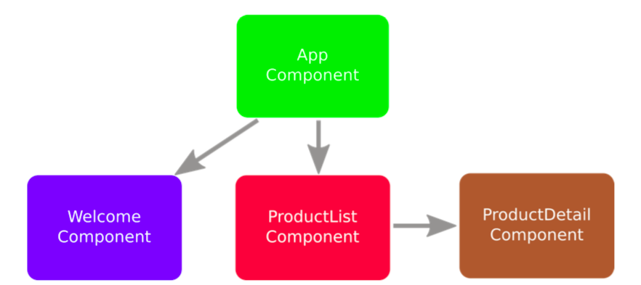
Routing Basics
index.html is the only HTML page downloaded from the server and all our application is handled from this document.
how can we navigate to another view in our application?. This is handled by the Angular Router.

Slide 17
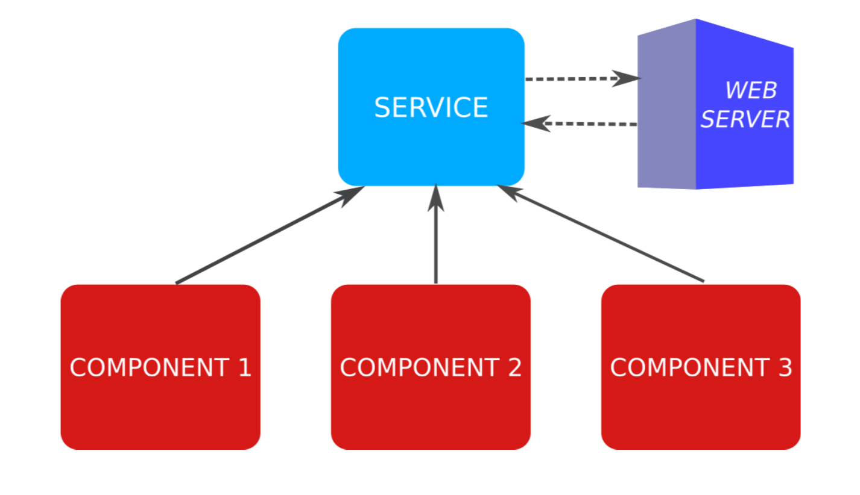
Services
A service is a class whose purpose is to provide some data and logic shared between different components.

Slide 18
RxJS and Observables
When doing HTTP resquests with Angular, we could work with Promises if we wanted to, but instead, by default, Angular 2+ works with Observables, which can be seen as a more advanced version of a Promise, with more features.
In order to do so, Angular uses an additional library called RxJs.

Slide 19
differences between Promises and Observables
 | Promise | Observable
What does it provides ? | Only a single future value. | A single Observable can provide multiple values over time.
When it starts ? | When it’s created. | Only start when you subscribe to it (lazy loading).
Can it be canceled ? | No. | After unsubcribing.
How is it processed ? | It just uses the generic method “then” for processing data. | It has useful methods such as map, filter, reduce and many more.

Slide 20
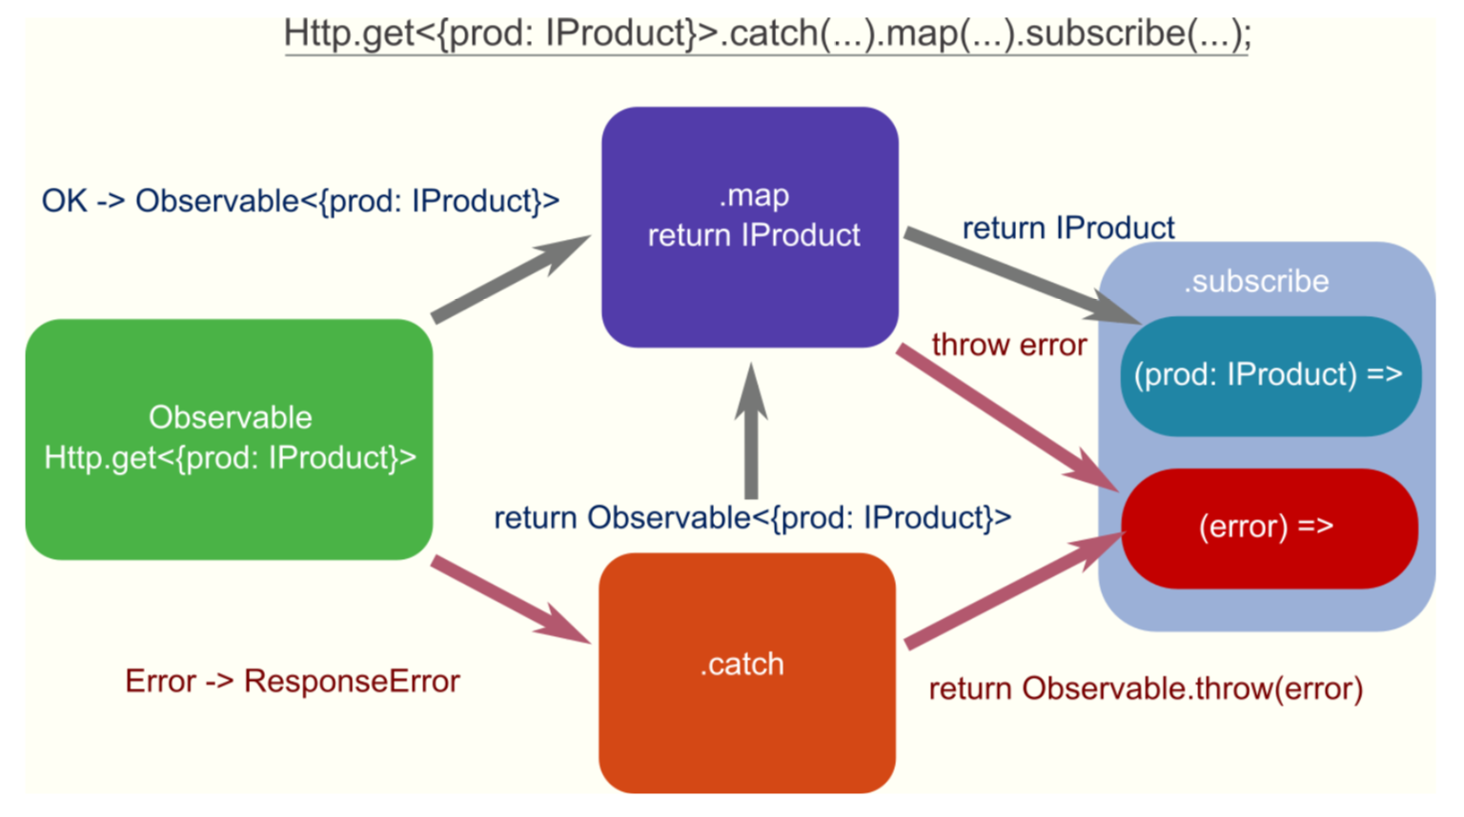
Handling responses and errors with observables
An observable doesn’t start until subscribed to somewhere. The method subscribe is a final method.

Slide 21

QUESTIONS?

Slide 22

Thank you for your assistance

